Slide 1
[2020 KOHI]
Semantic segmentation
Medical Imaging & Intelligent Reality Lab (MI2RL)
Asan Medical Center
Keewon Shin

Slide 2
Contents
(Lecture) What is semantic segmentation? : 10 min
Definition : Segmentation
Why do we need semantic segmentation?
Segmentation in medicine
Traditional segmentation
(Lecture) Segmentation using Deep learning : 15 min
Dataset
Metric
Loss
Fully Convolutional Networks
U-Net
(Hands On) 2D segmentation : 40 min
(Break time) : 15 min
(Hands On) 3D segmentation : 20 min
(Lecture) Discussion : 10 min

Slide 3
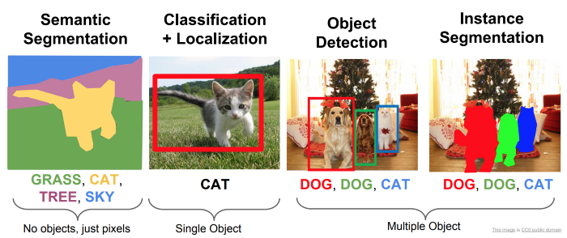
What is semantic segmentation?
Definition : Segmentation
Simple & easy to label
For a given image, areas or structures are displayed as output by analyzing information such as
color, edge, pattern, and orientation.
from Fei-Fei Li Stanford Course — Detection And Segmentation
Notes:
이미지가 주어졌을 때 색상, 엣지, 패턴, 방향 등의 정보를 분석하여 영역 또는 스트럭처가 아웃풋으로 나오는 것.

Slide 4
What is semantic segmentation?
Definition : Segmentation
Image Classification: Classify the main object category within an image.
Object Detection: Identify the object category and locate the position using a bounding box for every known object within an image.
Semantic Segmentation: Identify the object category of each pixel for every known object within an image. Labels are class-aware.
Instance Segmentation: Identify each object instance of each pixel for every known object within an image. Labels are instance-aware.
Notes:
이미지가 주어졌을 때 색상, 엣지, 패턴, 방향 등의 정보를 분석하여 영역 또는 스트럭처가 아웃풋으로 나오는 것.

Slide 5
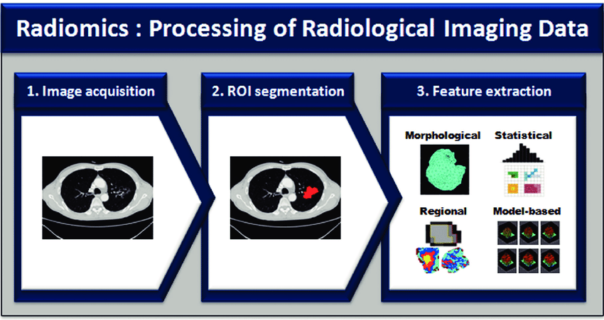
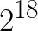
What is semantic segmentation?
Why do we need semantic segmentation?
Precision analysis
Necessary but annoying
Ex) Radiomics
Our criteria are based on spatial information
There are numerous amounts of information in the image. (ex 512 * 512 * 1 = )
CNN finds features well, but if you give key local information, the performance increases.
Good for quantitative analysis and quantification.

Slide 6
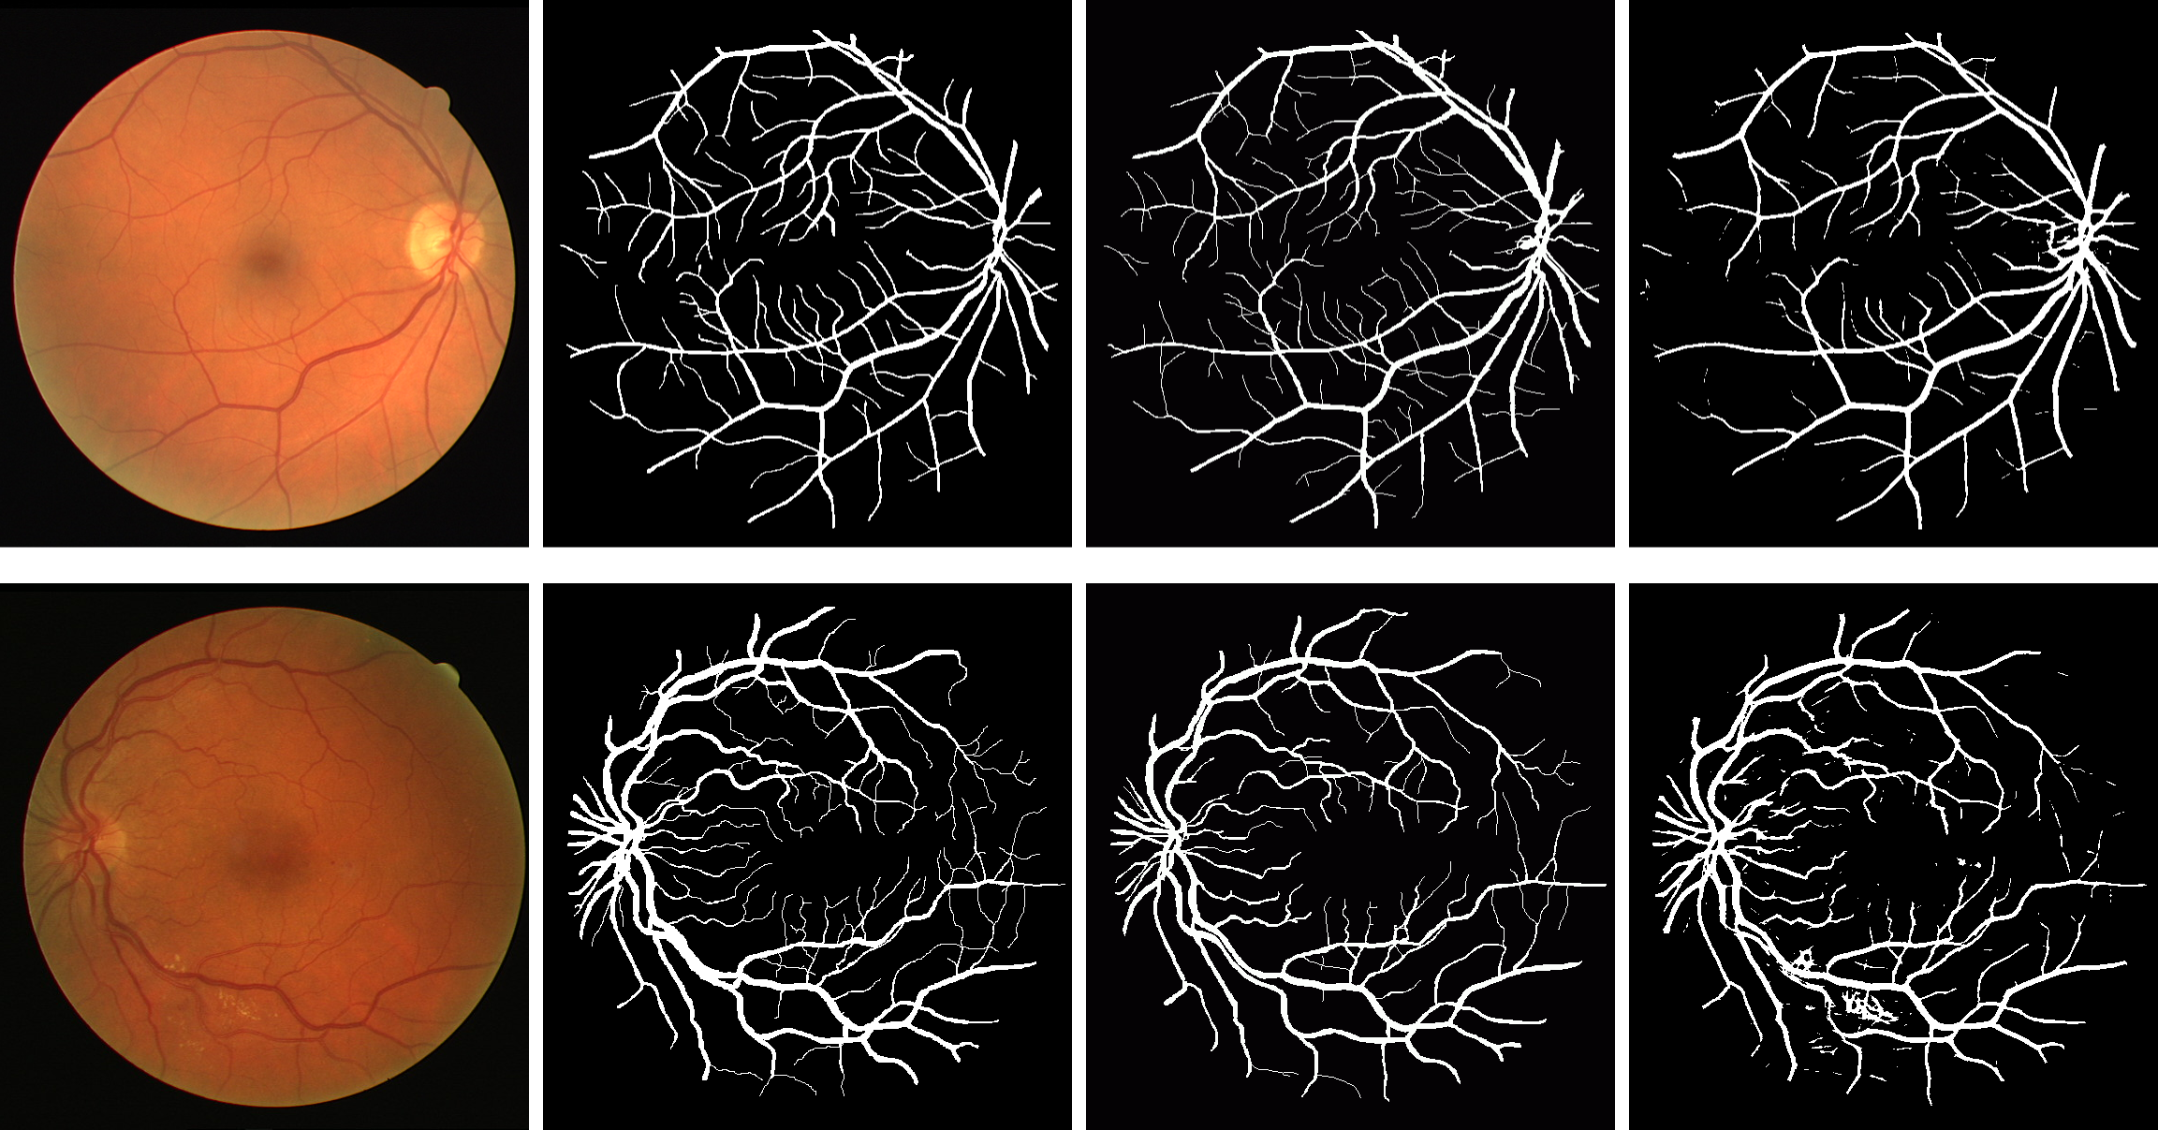
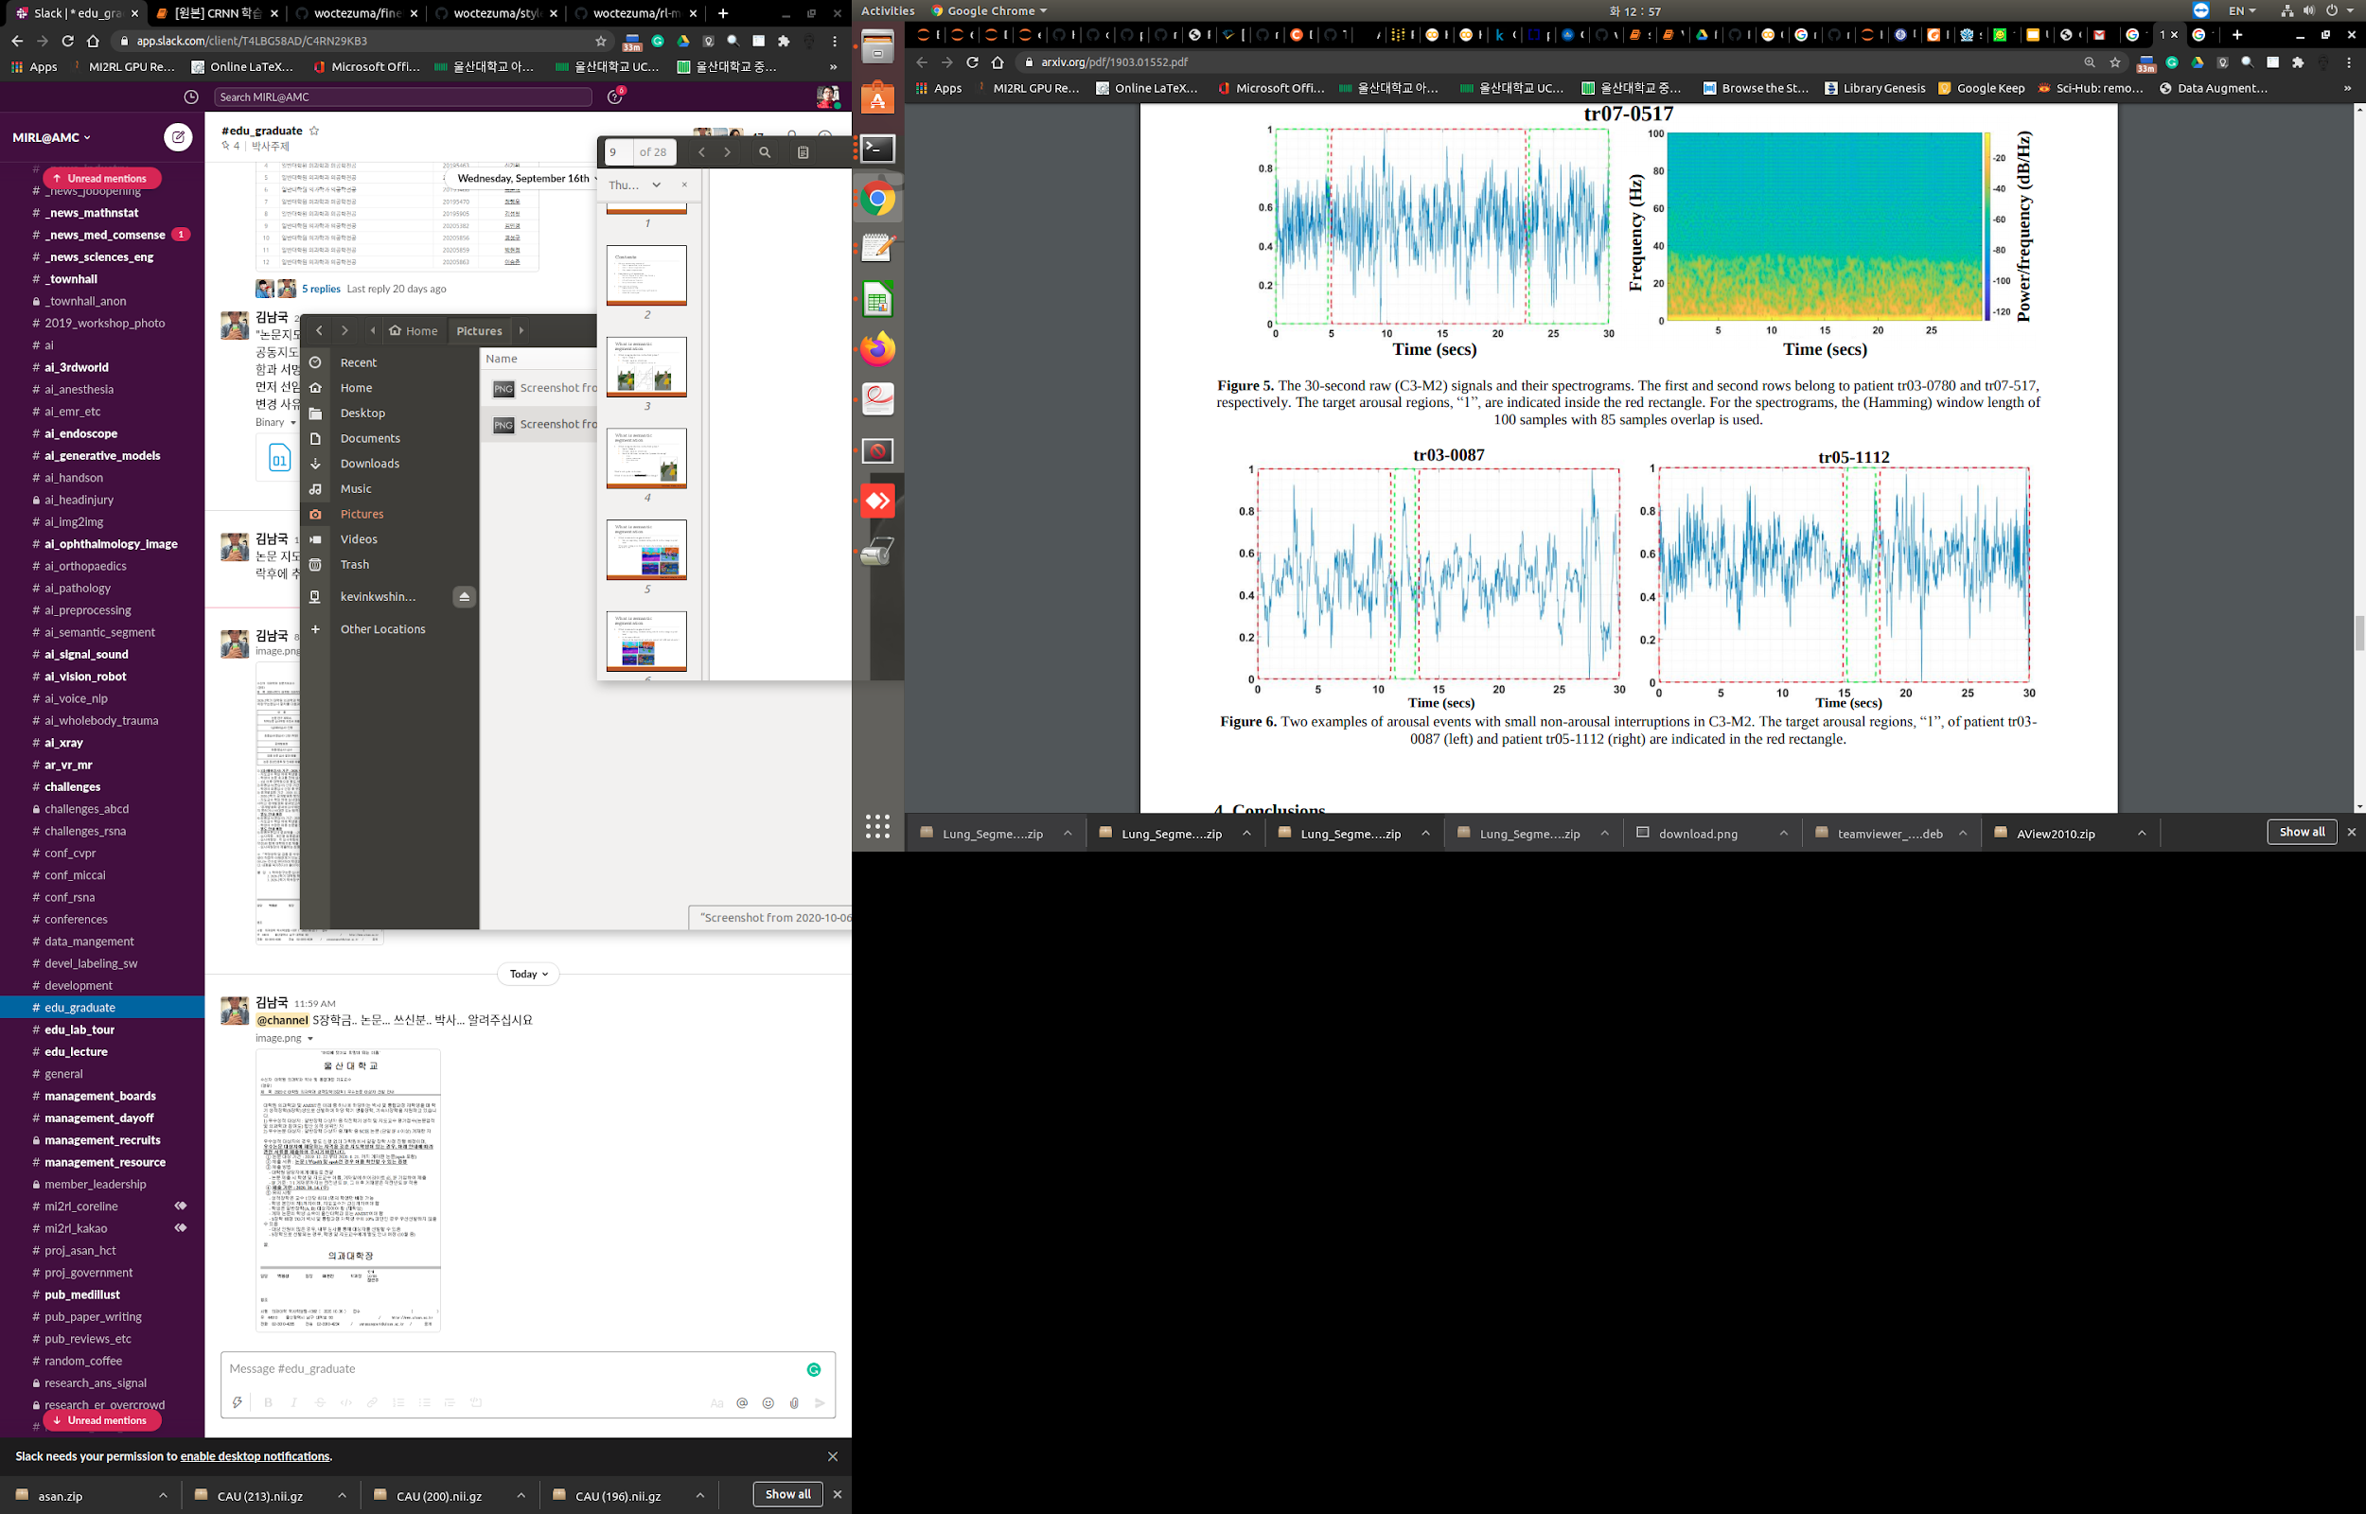
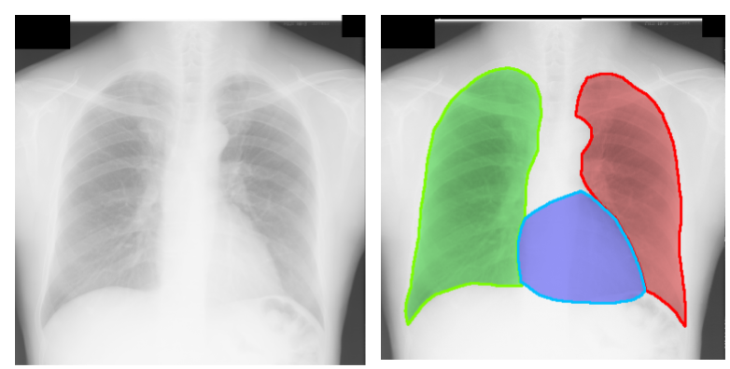
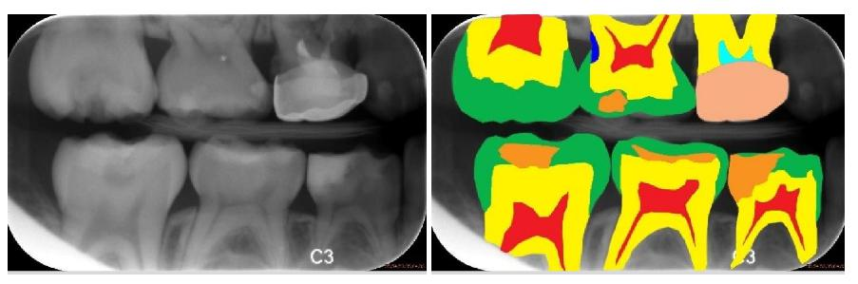
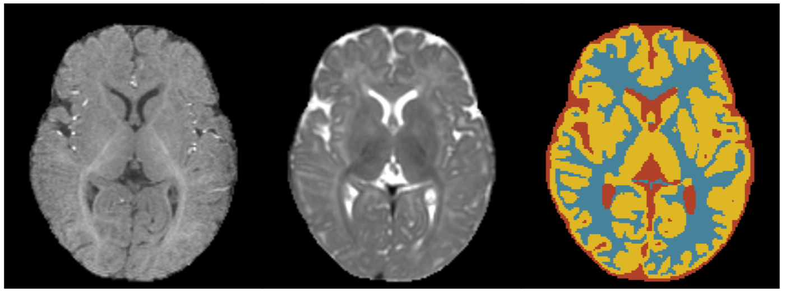
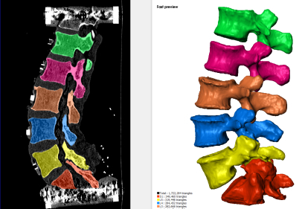
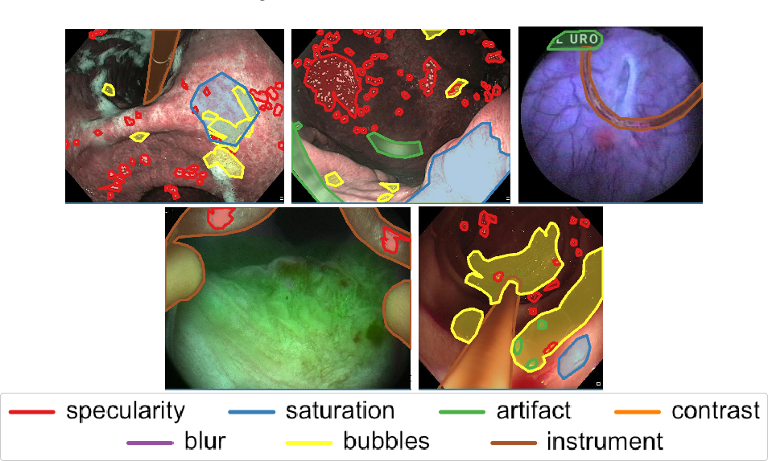
What is semantic segmentation?
Segmentation in medicine
1D : Signal (N x s x C) | 2D : image (N x H x W x C)
3D : 3D image (N x D x H x W x 1) image with time (N x T x H x W x 1) | 4D : Multi modal 3D image (N x D x H x W x C)
Event

Slide 7
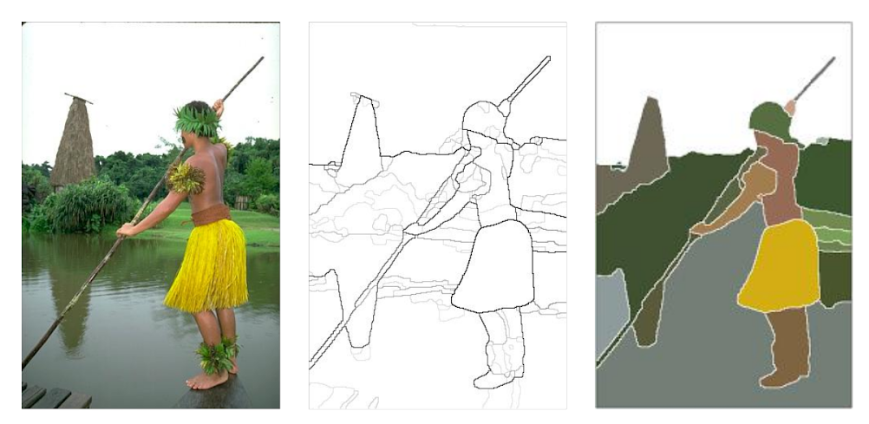
What is semantic segmentation?
Traditional segmentation

Slide 8
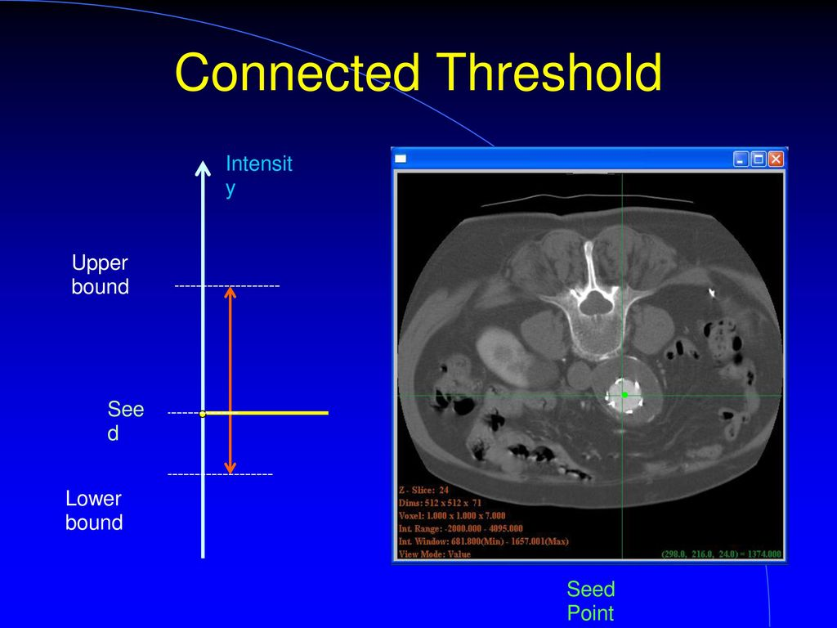
What is semantic segmentation?
Traditional segmentation
from “ITK Segmentation Methods"

Slide 9
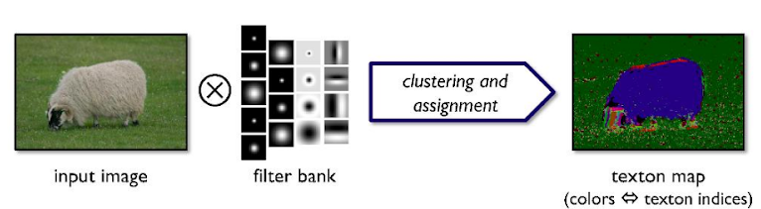
What is semantic segmentation?
Traditional segmentation
Tingwu Wang et al. [2]

Slide 10
Segmentation using Deep learning
Workflow of segmentation using deep learning
Dataset class, size, shape imbalanced? Different protocol, ROI? Sensitive label, multi labeler?
Preprocessing bit? Modality?
Metric Dice, IoU, distance, FROC?
Loss function CE, Dice, Tversky, Boundary?
Model U-net, Pyramid?
Evaluation False positive, False Negative?

Slide 11
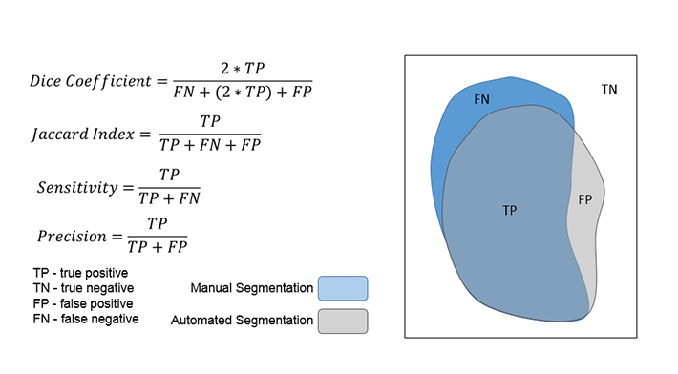
Segmentation using Deep learning
Metric
Dice
IoU(Intersection over Union)
Jaccard
Hausdorff Distance
FROC
...

Slide 12
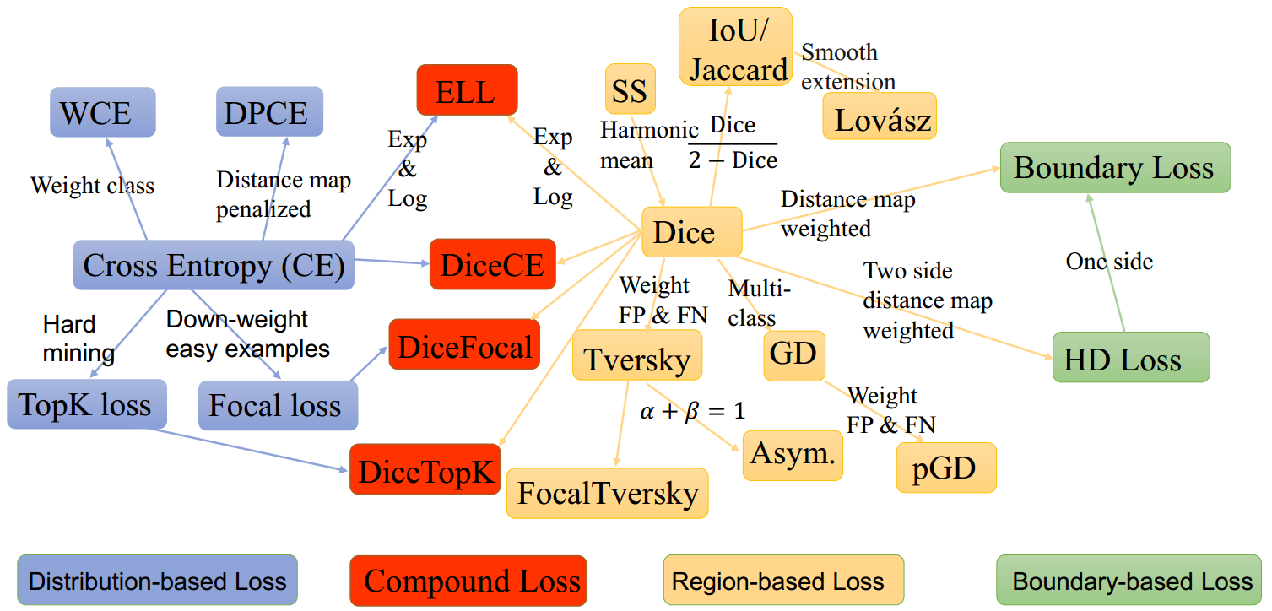
Segmentation using Deep learning
Loss function
Images from [5] https://github.com/JunMa11/SegLoss

Slide 13
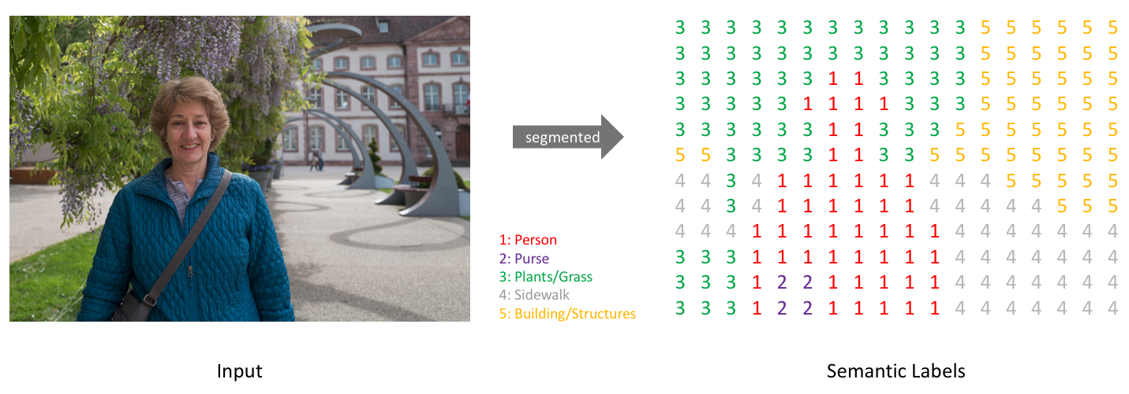
Segmentation using Deep learning
Dataset

Slide 14
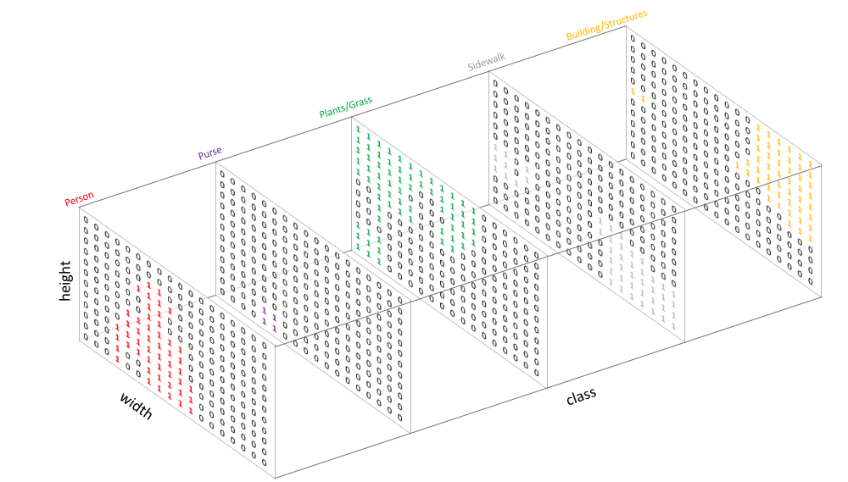
Segmentation using Deep learning
Dataset

Slide 15
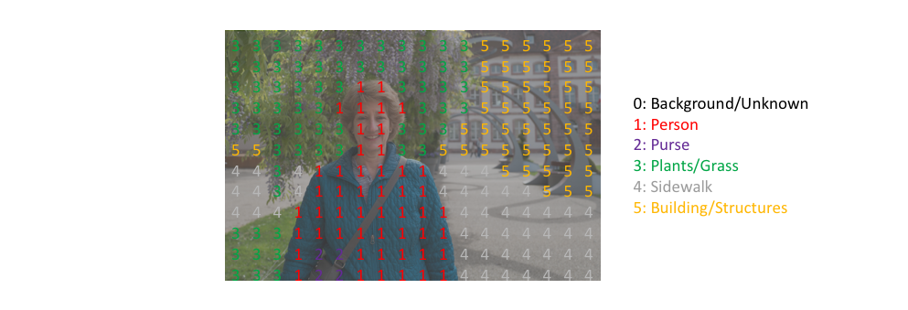
Segmentation using Deep learning
Dataset

Slide 16
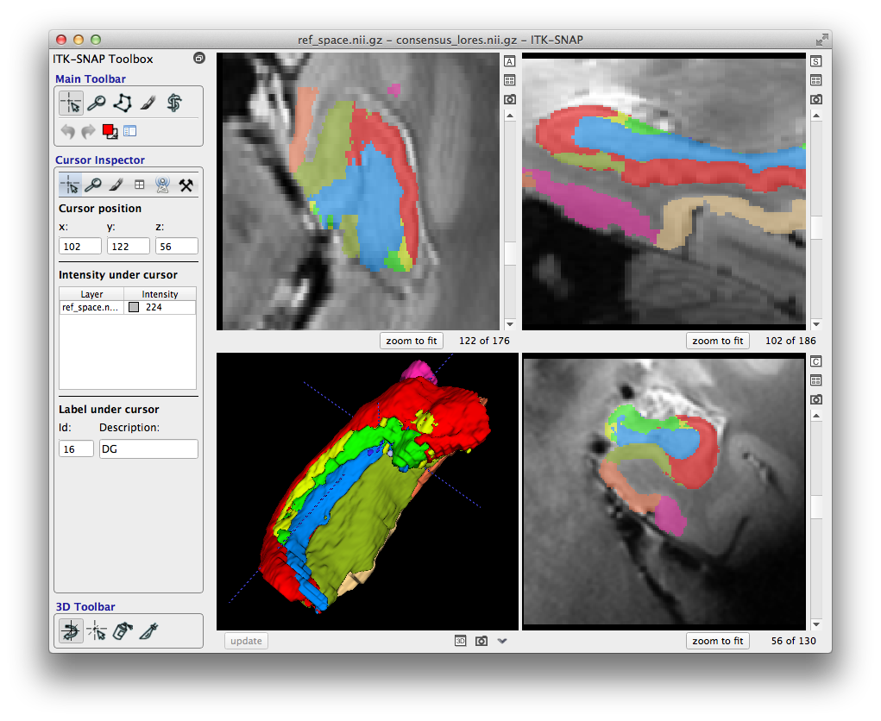
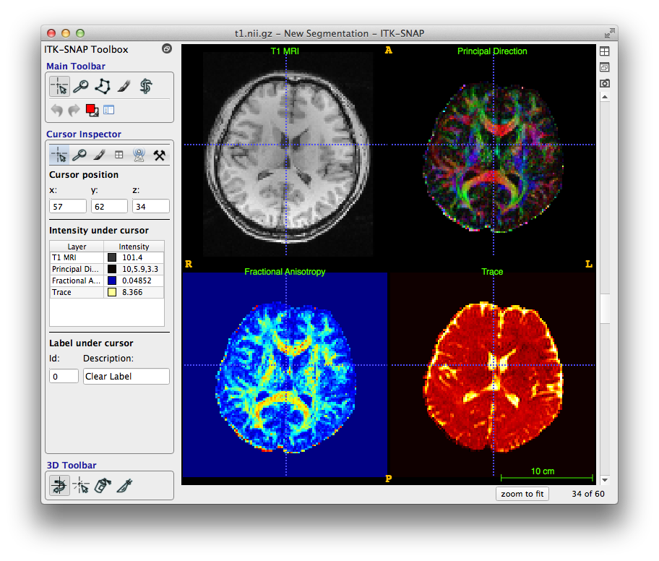
Segmentation using Deep learning
Medical labeling tool (ITK-SNAP)
http://www.itksnap.org/pmwiki/uploads/Train/RSNA2016-Handout-Exercises.pdf

Slide 17
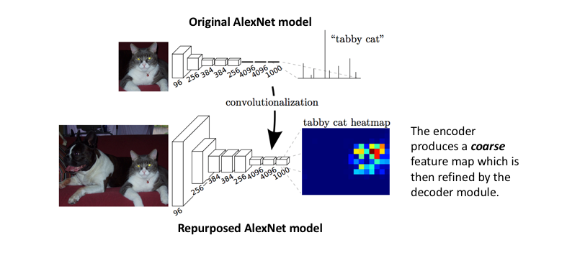
Segmentation using Deep learning
Fully Convolutional Network
Images from Fully Convolutional Networks for Semantic Segmentation

Slide 18
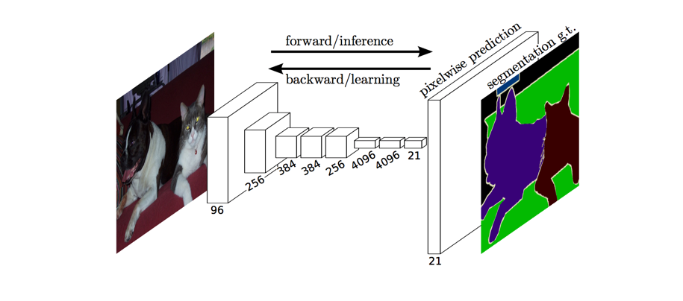
Segmentation using Deep learning
Fully Convolutional Network
Images from Fully Convolutional Networks for Semantic Segmentation

Slide 19
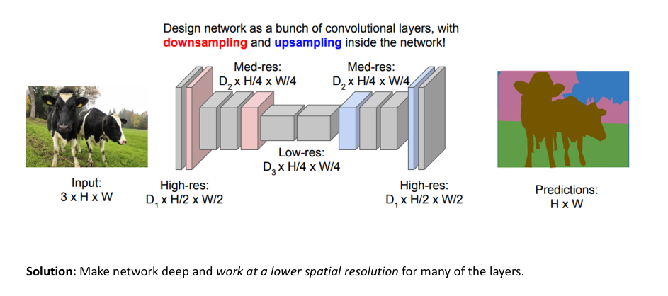
Segmentation using Deep learning
Fully Convolutional Network

Slide 20
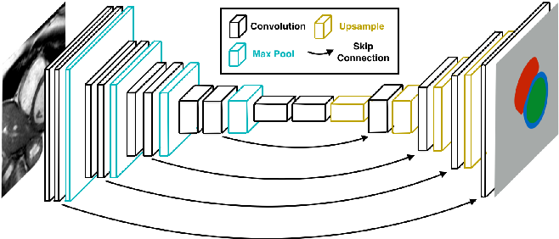
Segmentation using Deep learning
U-Net
Images from [5] groundai.com/

Slide 21
Hands on
[1]https://colab.research.google.com/github/kevinkwshin/Handson_segmentation/blob/main/SemanticSegmentation_KOHI_2D.ipynb
[2]https://colab.research.google.com/github/Project-MONAI/tutorials/blob/master/3d_segmentation/spleen_segmentation_3d.ipynb

Slide 22
Discussion
SOTA model and method : https://paperswithcode.com/task/medical-image-segmentation
False positive reduction
post-processing
cascaded network
2nd label
learning post-processing
Open source? : nnU-Net / MONAI
Multi-organ segmentation
: http://medicaldecathlon.com/

Slide 23
Reference
[1] https://www.jeremyjordan.me/semantic-segmentation/
[2] Semantic Segmentation, Tingwu Wang, Machine learning group, University of Toronto
[3] Fully Convolutional Networks for Semantic Segmentation, Jonathan Long, et al.
[4] CS231n: Convolutional Neural Networks for Visual Recognition, Stanford University,
[5] https://www.groundai.com/project/fastventricle-cardiac-segmentation-with-enet/
[6] https://glassboxmedicine.com/2020/01/21/segmentation-u-net-mask-r-cnn-and-medical-applications/
[7] https://github.com/JunMa11/SegLoss

